Slide 1


React & Firebase
#1 Deploy to Firebase Hosting

Slide 2


?
How to Deploy
React Project to
Firebase Hosting

Slide 3

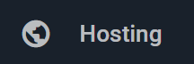
Firebase Hosting provides fast and secure static hosting for your web app.
Firebase Hosting is production-grade web content hosting for developers. With Hosting, you can quickly and easily deploy web apps and static content to a global content-delivery network (CDN) with a single command.

Slide 4
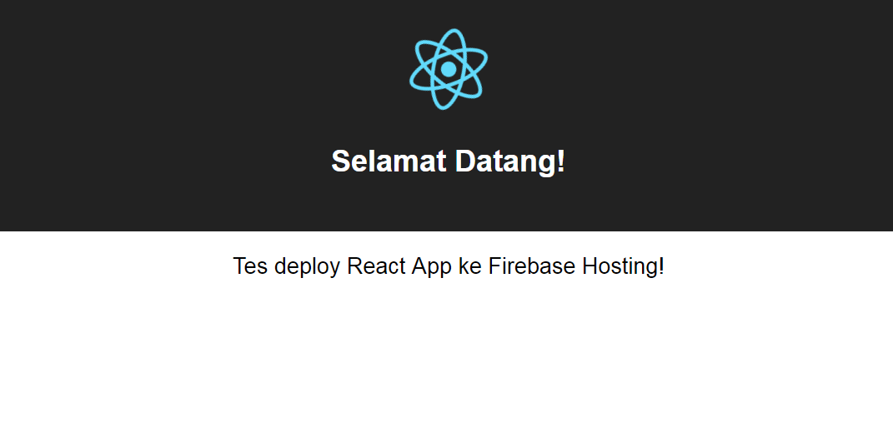
https://linyoa-37d9d.firebaseapp.com/

Slide 5
#1 Create/Prepare Your React App
Install create-react-app utility globally on your PC (if you have not done yet before)
$ npm install -g create-react-app
Create a new react app or prepare yours
$ create-react-app linyoa
$ cd linyoa
Make sure that it runs successfully
$ npm start
$ npm run build

Slide 6
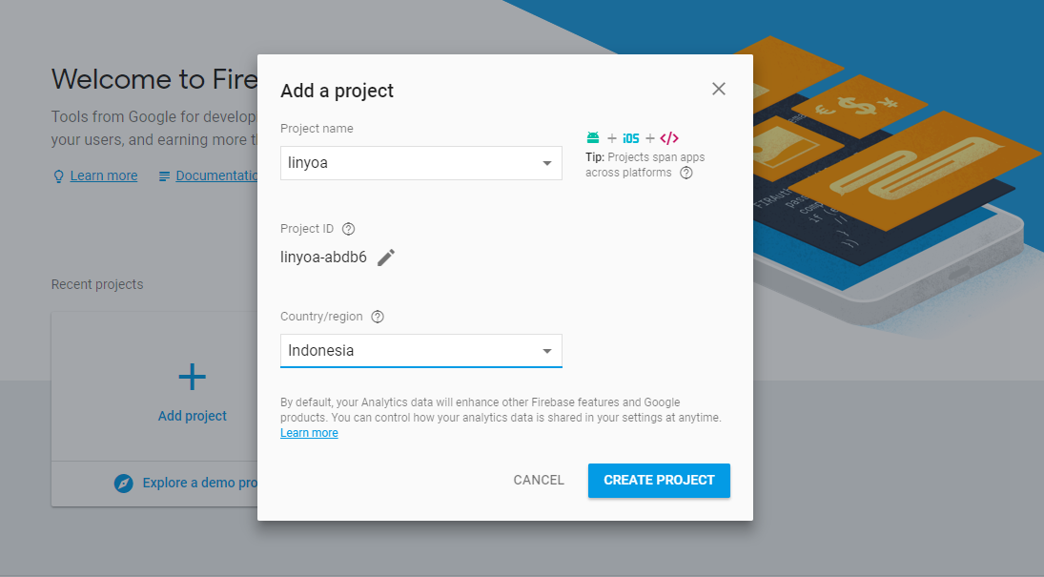
#2 Create Firebase Project

Slide 7
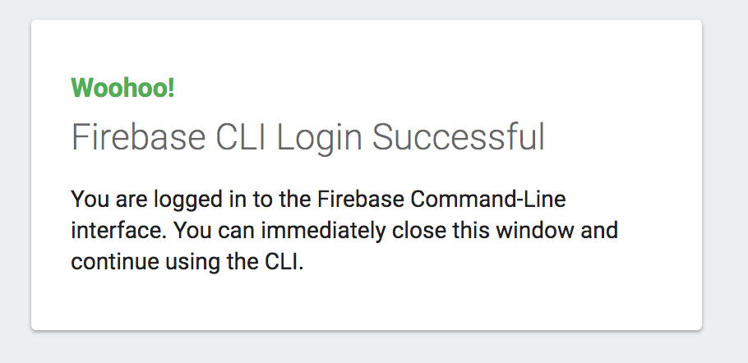
#3 Setup Firebase CLI
Install Firebase CLI
$ npm install -g firebase-tools
Login to your Firebase account
$ firebase login

Slide 8
#4 Firebase initialization
Firebase initialization
$ firebase init
? Are you ready to proceed? (Y/n) y
? Which Firebase CLI features do you want to setup for this folder?
Press Space to select features, then Enter to confirm your choices.
(Press <space> to select)
>(*) Database: Deploy Firebase Realtime Database Rules
( ) Firestore: Deploy rules and create indexes for Firestore
( ) Functions: Configure and deploy Cloud Functions
(*) Hosting: Configure and deploy Firebase Hosting sites
( ) Storage: Deploy Cloud Storage security rules
? Select a default Firebase project for this directory:
[don't setup a default project]
> linyoa (linyoa-37d9d)
[create a new project]

Slide 9
? What file should be used for Database Rules? (database.rules.json)
? What do you want to use as your public directory? (public)
build
? Configure as a single-page app (rewrite all urls to /index.html)? (y/N)
y
? File build/index.html already exists. Overwrite? (y/N)
n
Firebase initialization complete!

Slide 10
#5 Deploy!
Deploy to Firebase Hosting!
$ firebase deploy
=== Deploying to 'linyoa-37d9d'...
i deploying database, hosting
i database: checking rules syntax...
+ database: rules syntax for database linyoa-37d9d is valid
i hosting: preparing build directory for upload...
+ hosting: 10 files uploaded successfully
i database: releasing rules...
+ database: rules for database linyoa-37d9d released successfully
+ Deploy complete!
Project Console: https://console.firebase.google.com/project/linyoa-37d9d/overview
Hosting URL: https://linyoa-37d9d.firebaseapp.com

Slide 11
https://linyoa-37d9d.firebaseapp.com/

Slide 12
React & Firebase
#1 Deploy to Firebase Hosting

